Slide 1
Intermodal 3-Corridor Network

Slide 2
1: Link type
The attributes of different link types are different.

Slide 3
2: demand type permitted on different links
Demand types:
1: SOV
2: Parking & Ride
3: BRT

Slide 4
2: demand type permitted on different links
Path illustrations:
1: SOV
2: Parking & Ride
3: BRT

Slide 5
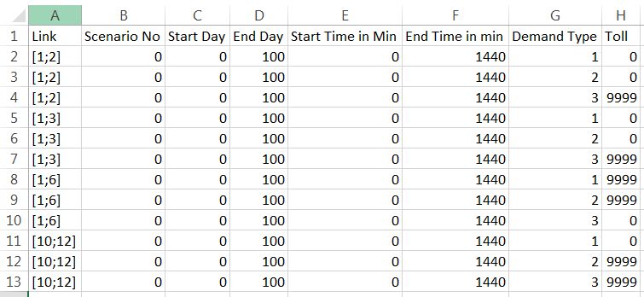
2: demand type permitted on different links
The function is realized by specific settings in scenario_toll.csv.
If the demand type is permitted, its toll is 0; otherwise, one big toll value (9999) is put on this link to prohibit this demand type.

Slide 6
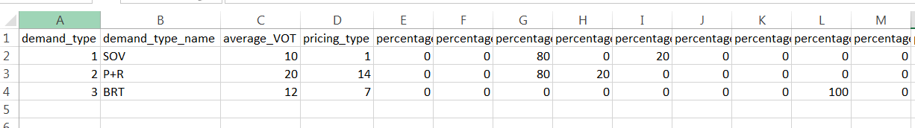
3: settings in input_demand_type.csv
Define your demand types in input_demand_type.csv. Meanwhile, in this csv file, you can define average VOT, pricing type, percentage of vehicle types, VOT distribution.

Slide 7
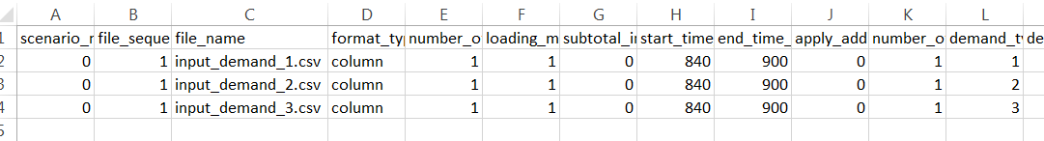
4: settings in input_demand_FIFE_LIST.csv
Based on your demand file for different demand types, you can set up your OD demand in this csv file.

Slide 8
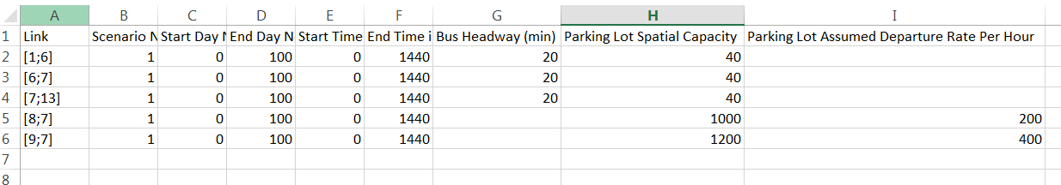
5: settings in Scenario_Park_And_Ride.csv
For the link type as transit (BRT), it defines the headway and bus capacity;
For the link type as partking & ride, it defines the spatial capacity of the parking lot and its assumed departure rate.

Slide 9
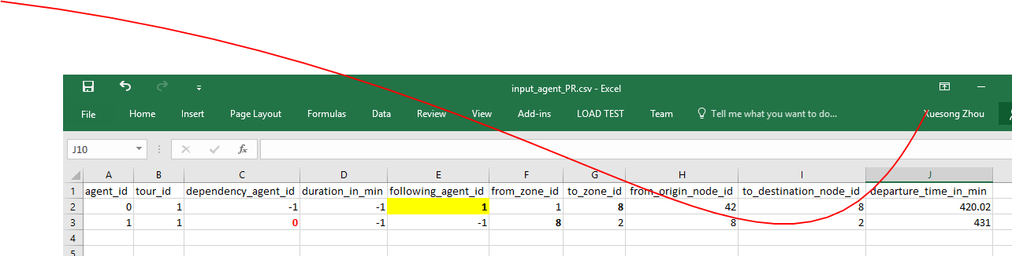
6: INPUT_agent with two trips

